Slide 1
Contents １．Current situation of “Geotechnical BIM” in Japan ２．Case Studies ３．Ground information to be delivered with IFC? ４．3D ground models and their use scenes
Geotechnical BIM in Japan
January 22, 2019
Hiro Shima, Shoichi Nishiyama, Rie Wada
OYO Corp.

Slide 2



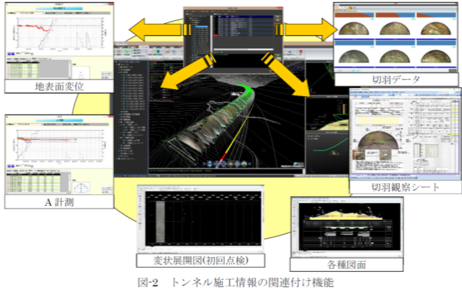
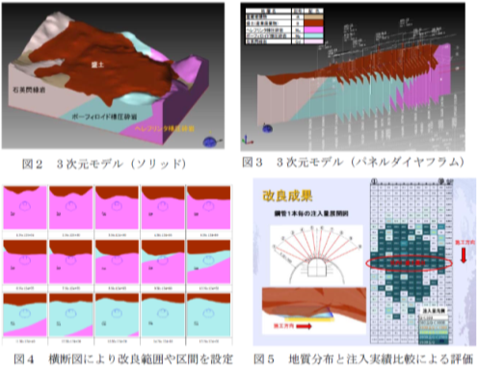
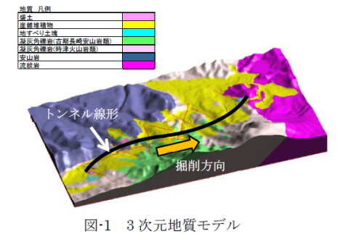
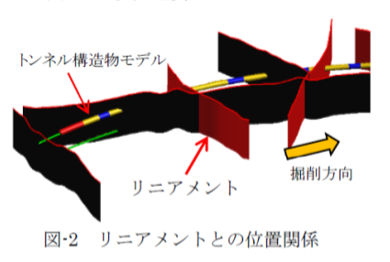



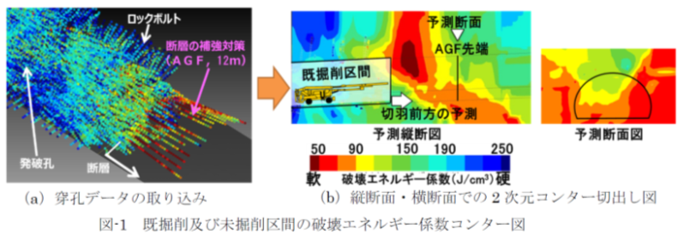
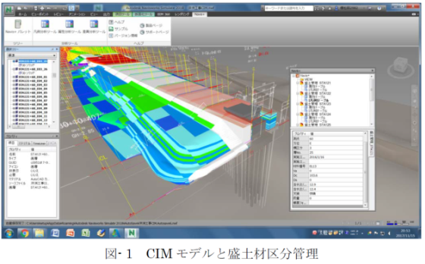
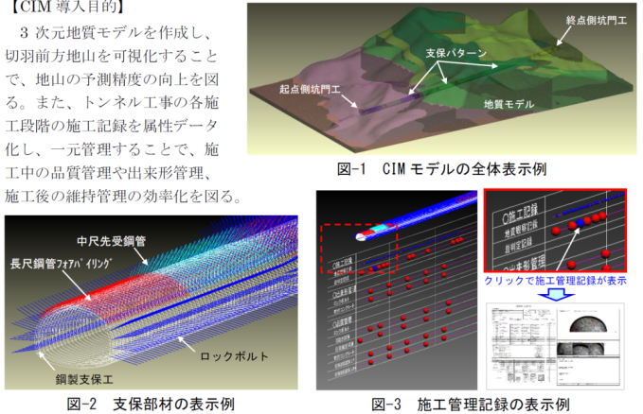
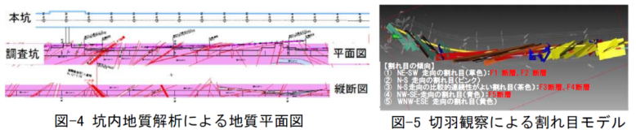
Major Japanese general constructors are including geotech. info. in BIM
１
引用：一般社団法人日本建設業連合会 2018施工CIM事例集
2

Slide 3
OYO's experiences in 3-D subsurface modeling
1
Analysis and investigation
□Landslide
□Liquefaction
□Groundwater Flow
□Terrain topography
□Soil/Groundwater pollution
□Active fault
□River bank
□Historical site
□Geothermal
Solution
□Road
□Tunnel
□Building
□Dam
□Disposal site
□Energy Plant
□Airport
□Urban development etc.
Business segments where 3-D modeling were used
＜2003 - 2018: Total 519 cases＞
3
Notes:
Let me introduce OYO's 3-D subsurface modeling works.
This pie chart shows the business fields to which OYO has been applied 3-D modeling during the 15 years from 2003（two thousand three） to 2018(twenty eighteen ).
The most common field is the tunnel and road works, the second is resource and energy development, and the third is slope disaster prevention field.

Slide 4
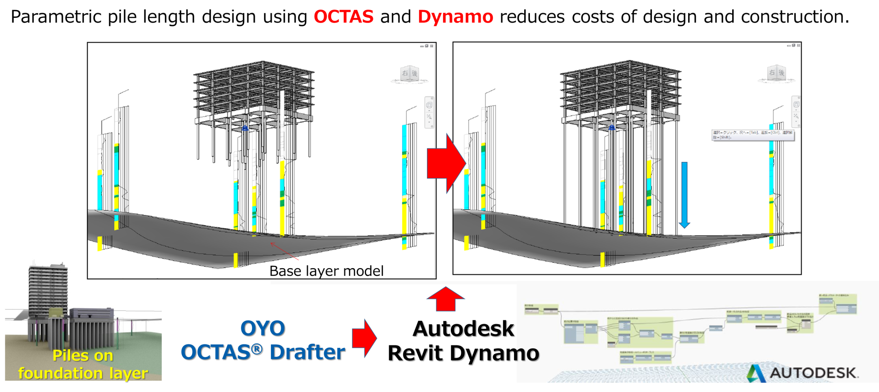
Integration of geotechnical software and BIM software
１
引用：RUG（Revit User Group）年次総会2018発表資料：地盤情報タスクフォース活動報告
4

Slide 5
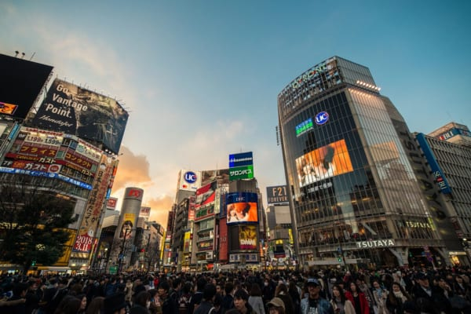
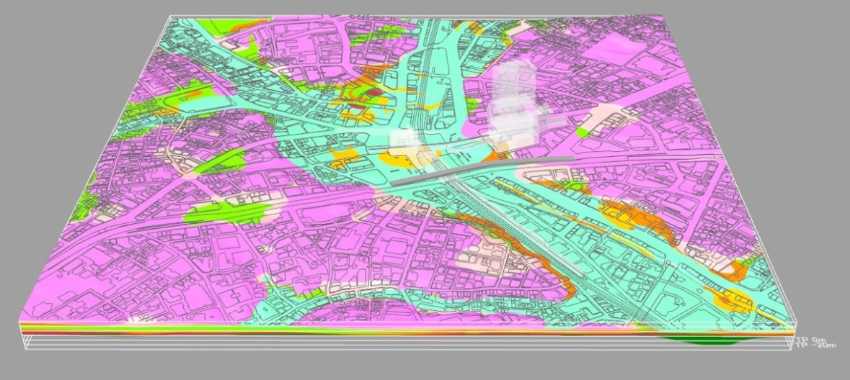
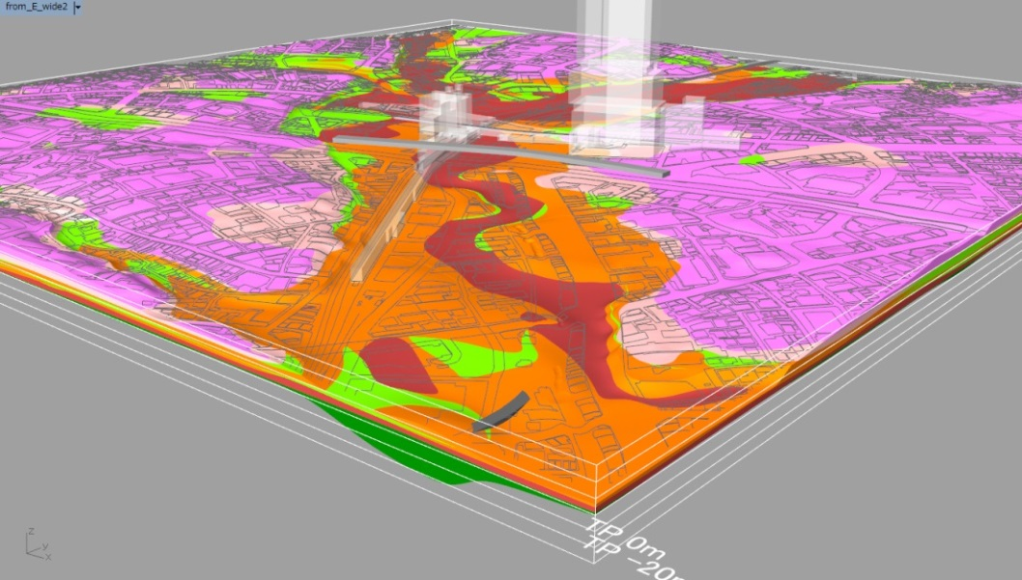

Casestudy-1: Risk assessment for an urban redevelopment in Tokyo
２
After man-made soil layer is peeled off.
https://sirabee.com/2018/11/01/20161861175/
Purposes of 3-D modeling
Find geotechnical risks for construction and maintenance
Common understanding of subsurface structure among stakeholders
Cost-effective investigation, design and construction
After the alluvial layer is peeled off.
5
Notes:
Third example is risk evaluation associated with Urban development.
Shibuya is very famous to foreign visitors, and the Shibuya railway station is huge terminal station used at about 2 million people per day.
Actually, the Shibuya is fragile ground consist of valley allluvial plain made by two rivers.
we conducted 3-D modelling for
finding the geotechnical risks affecting construction and maintenance
Common understanding of subsurface structure among stakeholders, and
Cost-effective investigation, design and construction
※For example : lack of load bearing capacity, consolidation settlement, liquefaction, impact to groundwater flow
This is a snapshot of the model.
It shows a state that alluvial layer is peeled off.
Red layer is gravel layer which is load bearing layer in this area. The distribution of the red gravel layer can be understood visually.
※peel blue :alluvial mud layer
yellow green 洪積粘性土
orange 洪積砂質土
brown 洪積砂礫層
pink ローム
peel pink ローム質砂質土
green 洪積粘性土（深いほう）

Slide 6
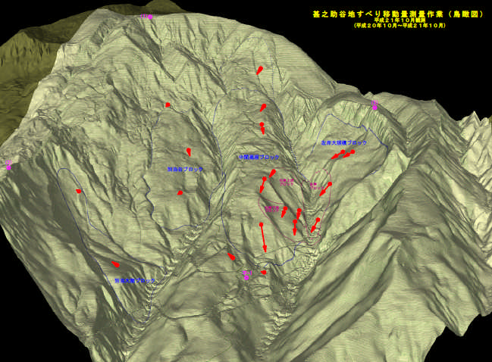
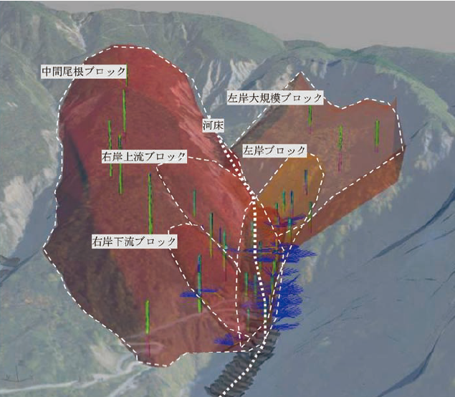
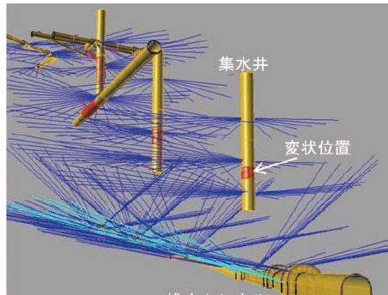
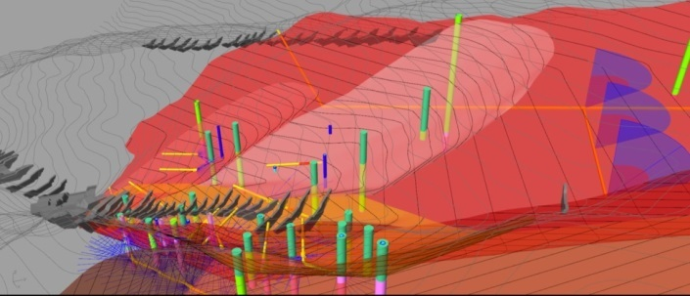
Casestudy-2: Evaluation and planning of landslide countermeasures
２
Source :
http://210.148.110.37/library/happyoukai/h22/anzen_anshin/05.pdf#search=%27%E7%94%9A%E4%B9%8B%E5%8A%A9+%E5%9C%B0%E3%81%99%E3%81%B9%E3%82%8A%27
6
Notes:
Second example is the landslides.
This photo shows whole view of the landslide area. Red line indicates the landslide.
They consists of 4 blocks and the total soil amount is about 34(thirty four) million cubic meter.
Right hand photo shows topographic map and red arrows show landslide movement
Measurement of the landslide movement started from 1927(nineteen twenty-seven). Up to now, it continues to move at a rate of about 10 cm per year.
When the sediment control dam built in the landslide area collapses due to landslides, a large amount of sediments must flow down to the downstream and cause serious disaster. So , 3D models were created for the evaluation and planning of countermeasures.
red surface is slip plane of the landslide
yellow lines are drainage tunnel and drainage well
navy line is drainage borehole
and, gray structure is sediment control dam
-------------------------
※Because the main cause of landslide is thought to be in groundwater supply by snow melting, measures are taken by groundwater drainage method such as drainage tunnel, drainage well.
※Landslides are in the area of altitude about 1800 (one thousand eight hundred) m.
※the largest landslide is about 2000 m long, 500 m wide, 130 m thick.
※Geology: Jurassic ～Cretaceous sandstone and shale. volcanic deposits cover them. they are weathered due to hydrothermal alteration.
※10 drainage tunnels, 900 meters total, 3 drainage wells, water collecting borehole, 21756 m total.

Slide 7
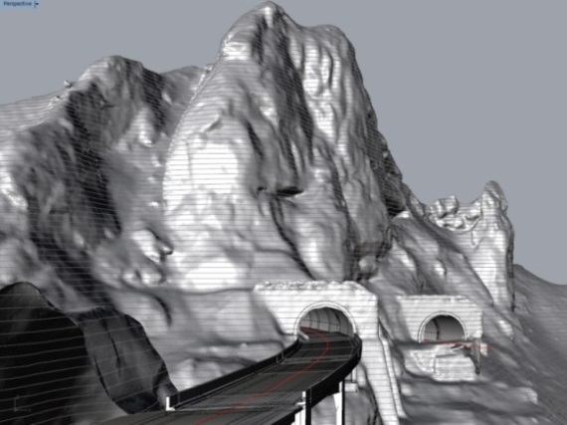
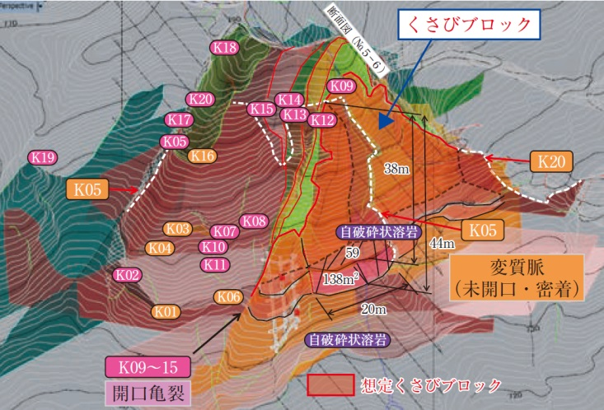
Casestudy-3: Stability of a tunnel mouth under an unstable rock mass
２
3D clack model
wedge shape block
H≒70m
altered dyke
(close contact)
Terrain model by airborne laser scanner
boundary of wedge block
open crack
Source：Watanabe et.al. ” Rock collapse risk reduction of the west wellhead of Joshinetsu road KitanoMaki tunnel ”. The foundation engineering & equipment, monthly , 45(7), 32-34, 2017-07 (in Japanese)
7
Notes:
The first case comes from a mountain tunnel.
As you see here, the tunnel mouth is built under a very steep cliff with height of around 70m.
And the cliff consists of sedimental rooks and an altered dyke with several open cracks.
An unstable wedge shape rook mass of 60,000(sixty thousand) cubic meter was found and the owner of highway decided to remove it.
To analyze the interaction between the ground and tunnel structure, and to plan and design safe process of rock mass removal, a 3D subsurface model plays a crucial role.

Slide 8
What information should be delivered?
３
1. 3D object in geotechnical information
⇒ borehole log, outcrops, geophysical exploration, panel diagram, surface model, solid model, etc.
2. IFC schema might miss important information
Geotech. information
We should
1. define the 'geotechnical info.‘ and '3D geotechnical model‘,
2. research use cases,
3. extract attribute information,
4. set the priority order, then
5. set IFC schema.
‘Geotech’-IFC
3-D Geotech. model
3. Subsurface model always includes “uncertainty” because;
At beginning
With time
Underground is heterogeneous in nature.
Subsurface model is based on a human interpretation.
Investigation method itself has uncertainty, e.g. limited sensor coverage.
Observed data and analyzed results include uncertainty, e.g. approximation in theory.
Accuracy of construction is affected by real natural ground condition.
Ground is naturally changing, e.g. consolidation, creep, temperature effect.
Ground water is also moving.
8

Slide 9
Uncertainty of construction process and ground model
３
3D geological model supports decision making to remove, avoid, reduce, share “Geological Risk” at each stage.
Flow of construction project | Planning | Design | Construction | In-service
Flow of geological study
Quality and quantity of survey／Uncertainty of geological model
Basic plan
Basic design
Detail design
Implt.
Comp.
Maintenance
Preliminary study
Main study
Supplemental study
Supervising study
Maintenance study
High
Low
9

Slide 10
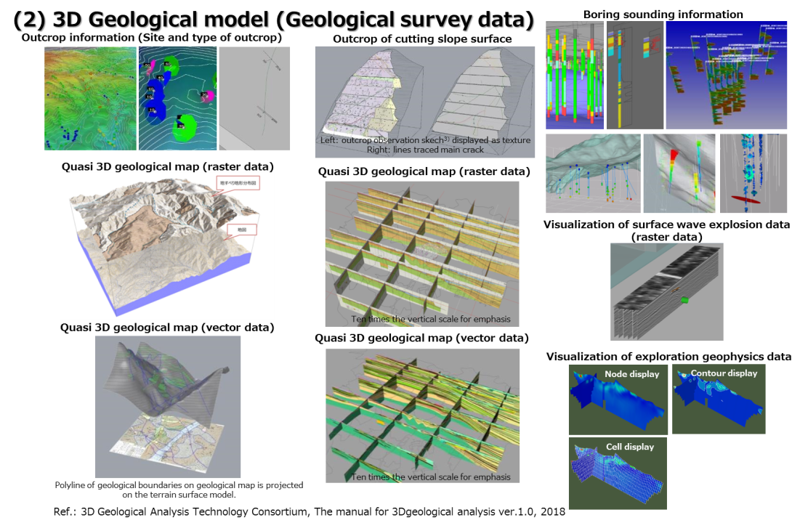
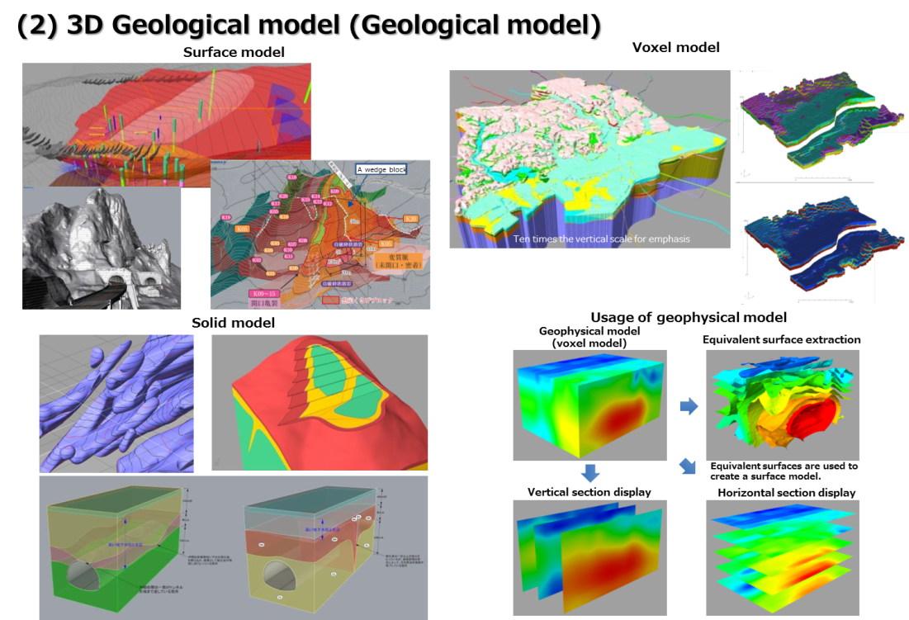
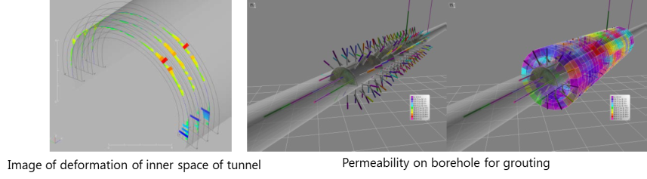
Examples of geological survey data and geological model
４
Quote:「3D Geological analysis manual」，3D Geological Analysis Technology Consortium, 2018
10

Slide 11
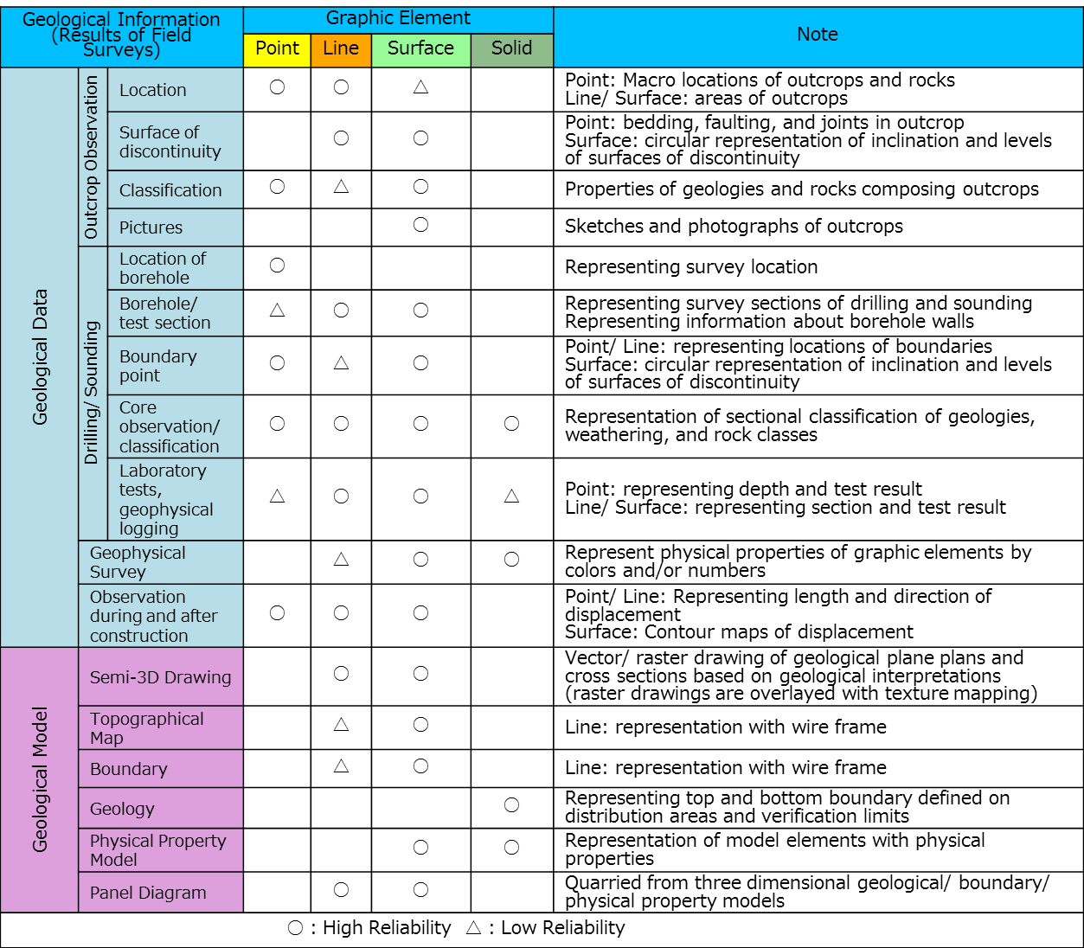
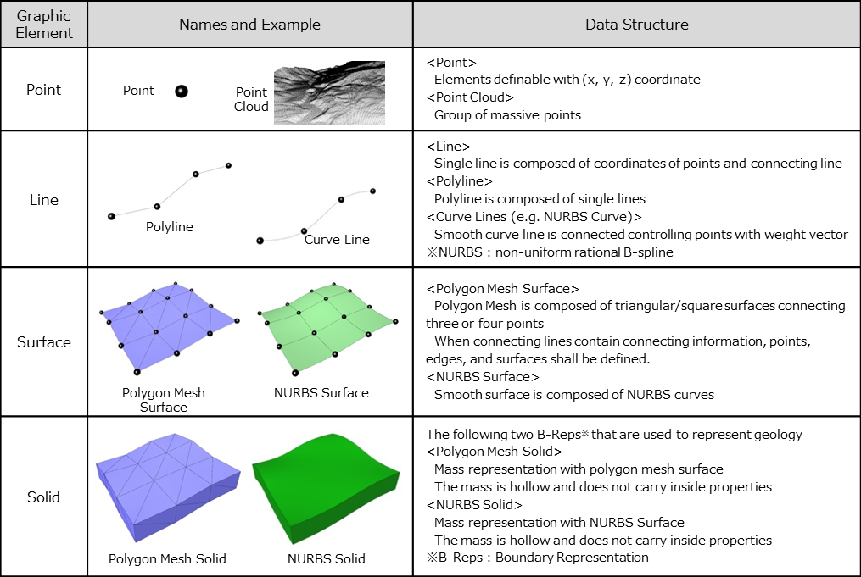
Major 3D Graphic Elements
４
Geological Information (Field Surveys) and Graphic Elements
Graphic Elements and Data Structures of 3D Geological Models
Quote:「3D Geological analysis manual」，3D Geological Analysis Technology Consortium, 2018
11

Slide 12
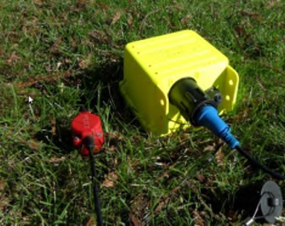
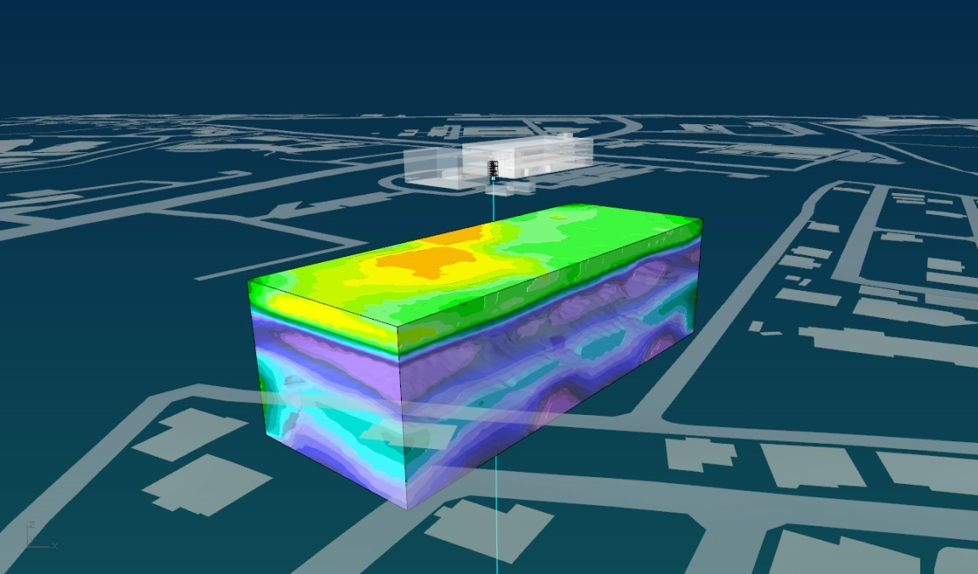
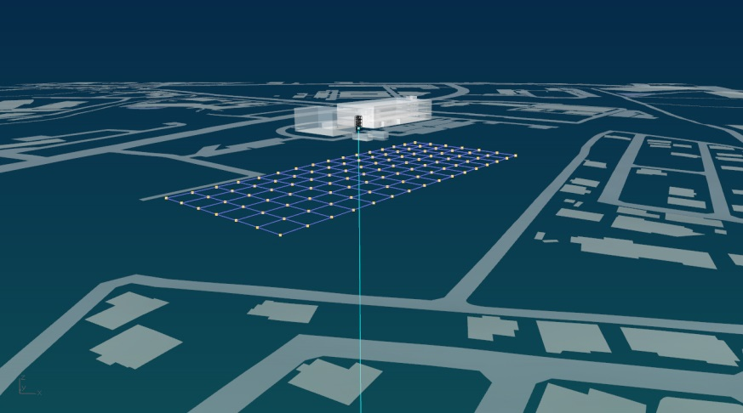
Geophysics help interpolate geotechnical data and image subsurface.
4
14cm
Wireless seismograph for ambient noise tomography
45m
in depth
After a few hours of measurement and successive data analysis, we can have subsurface 3D S-wave velocity structure. Yellow shows soft and blue shows hard soil.
Sensor array on the ground (7x16)

Slide 13
Utilization scene of 3D ground model
4
Uses of 3D Geological Model
Use Scenes of 3D Geological Model
Use | Objective
Secondary Use | Numerical calculations (simulations) Designing/planning supports Database Construction managements
Geological Analysis | Consistency tests Brainstorming
Visualization | Consensus forming Accountability Improved presentation
Use | Use Scenes | User
Secondary Use | Datasheet output | Project owners Constructors Consultants
 | Geological drawings (plane figures/ cross sections)
 | Geological drawings (contour maps of geological boundaries)
 | Basic Drawings (front views and perspective drawings) for required reports
 | Finite difference calculations of geological boundaries
 | Soil volume calculations in construction works
 | Use of 3D geological model itself
 | Processing into 3D model data for numerical analyses
Geological Analysis | Three dimensional consistency tests of geological information | Consultants
 | Geological modeling based on initial geological models
 | Updating models with accumulated data
Visualization | Locations of field surveys and results of surveys | Project owners Constructors Consultants
 | Results of geological surveys for building geological models
 | Estimated geological distributions and structures
 | Detailed geological model for construction sites
 | Detailed geological model for surfaces of discontinuities like cracks
 | Prediction models of soil/rock classifications
 | Results of geological analyses, safety factors, and areas of influence
 | Interference check between geological model and structures and constructions
 | Comparison between predicted models and actual survey results
 | Results of modeling
 | Geological parameters
 | Considerations in uses of geological models
 | Geological risk information (consideration in inspections, locations of hazards, causes, triggers, estimated damages)
 | Risks in designing and construction works
 | Geological risks in maintenance and rehabilitation
 | Links between geological properties and geological data/models
Major Uses of 3D Geological Model (N=79)
Quote:「3D Geological analysis manual」，3D Geological Analysis Technology Consortium, 2018
13

Slide 14
Thank you.

Slide 15
Efforts for solving ‘Uncertainty’
３
Related activities in Japan
１．The International Society for Soil Mechanics and Geotechnical Engineering - academic
A WG in Asia Technical Committee 10 (Urban Geo-informatics ) Japan chapter is developing “Guideline for quality evaluation of geological/geotechnical model”
The purpose is providing
a method by which the provider of the model can describe the information on its uncertainty
a way the user of the model can evaluate the uncertainty of the model
２．The Japan Geotechnical Consultants Association - industrial
3D geological analysis technology consortium consisted by 30 private companies are studying the standardization of procedure of 3-D geological/geotechnical modeling

Slide 16
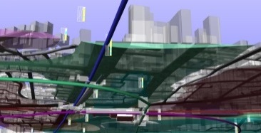


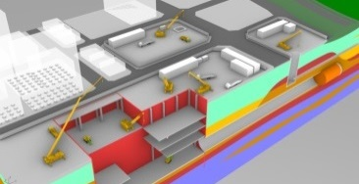


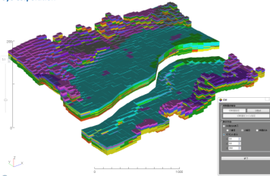

Users Benefits
4
Stakeholder
【type】
：Detailed model
：Detailed model for each purpose
【mesh size】
：5～100m
【model area】
：All areas
・Regional planning
・Operation and maintenance
・Risk management
・・・
Consultants
【type】
：Detailed model for each purpose
【mesh size】
：5～10m
【model area】
：Construction target area
・Construction plan
・Construction management
・Risk management
・・・
Constructors
【type】
：Overview model
【mesh size】
：250～500m
【model area】
：All areas
・Visualization
（Accountability）
Citizens
16
Notes:
建設事業に関わる様々なステークホルダは、個々にニーズが変わります。
必要な地盤情報を、必要な範囲で、ステークホルダに応じた表現やデータで提供する必要があります。
ステークホルダに対して、建設事業に関わる3次元地盤情報を提供し、利活用を図るのがこのシステム「3DGiP：3D Ground information Platform」の役割です。
建設事業に関わる様々なステークホルダは、個々にニーズが変わります。
Each stakeholders involved in various civil engineering business has their own needs.
必要な地盤情報を、必要な範囲で、ステークホルダに応じた表現やデータで提供する必要があります。
We, as a consultant, must provide appropriate subsurface information to each stakeholder in a form, which they requires.
ステークホルダに対して、建設事業に関わる3次元地盤情報を提供し、利活用を図るのがこのシステム「3DGiP：3D Ground information Platform」の役割です。
The role of this system (3DGip) is to provide necessary three dimensional ground information to the stakeholder and to utilize such information.

Slide 17
3D Objects Applicable to Use Scenes
4
Use | Use scenes of 3D model | Data from Field Surveys |  |  |  | Geological Model |  |  |  | Notes
 |  | Outcrop Observation | Drilling Sounding | Geophysical Surveys | Observation during and after construction | Semi-3D Drawings | Surface Model | Solid Model | Voxel Model
Secondary Use | Datasheet output |  | ● | ● | ● |  | ● | ● | ●
 | Geological drawings (plane figures/ cross sections) |  |  |  |  |  | ● | ●
 | Geological drawings (contour maps of geological boundaries) |  |  |  |  |  | ● | ● | ●
 | Basic Drawings (front views and perspective drawings) for required reports | ● | ● | ● | ● |  | ● | ●
 | Finite difference calculations of geological boundaries |  |  |  |  |  | ● | ● | ●
 | Soil volume calculations in construction works |  |  |  |  |  | ● | ● | ●
 | Use of 3D geological model itself | ● | ● | ● | ● | ● | ● | ● | ●
 | Processing into 3D model data for numerical analyses |  |  |  |  |  | ● | ● | ●
Geological Analysis | 3D consistency tests of geological information | ● | ● | ● | ● | ● | ▲※ | ▲※ | ▲※
 | Geological modeling based on initial geological models | ● | ● | ● | ● | ● | ● | ● | ●
 | Updating models with accumulated data | ● | ● | ● | ● | ● | ● | ● | ●
Visualization | Locations of field surveys and results of surveys | ● | ● | ● | ●
 | Results of geological surveys for building geological models | ● | ● | ● | ● | ●
 | Estimated geological distributions and structures |  |  |  |  | ● | ● | ●
 | Detailed geological model for construction sites | ● | ● |  |  |  | ● | ●
 | Detailed geological model for surfaces of discontinuities like cracks | ● | ● |  |  |  | ●
 | Prediction models of soil/rock classifications | ● | ● | ● |  | ● | ● | ● | ●
 | Results of geological analyses, safety factors, and areas of influence | ● | ● | ● | ● | ● | ● | ● | ●
 | Interference check between geological model, structures and constructions |  |  |  |  |  | ● | ●
 | Comparison between predicted models and actual survey results |  |  |  |  | ● | ● | ● | ●
 | Results of modeling | ● | ● | ● | ● | ● | ● | ● | ●
 | Geological parameters | ● | ● | ● | ● | ● | ● | ● | ●
 | Considerations in uses of geological models | ● | ● | ● | ● | ● | ● | ● | ● | Annotation requires
 | Geological risk information (consideration in inspections, locations of hazards, causes, triggers, estimated damages) | ● | ● | ● | ● | ● | ● | ● | ●
 | Risks in designing and construction works | ● | ● | ● | ● | ● | ● | ● | ●
 | Geological risk in maintenance and rehabilitation | ● | ● | ● | ● | ● | ● | ● | ●
 | Links between geological properties and geological data/models | ● | ● | ● | ● | ● | ● | ● | ●
 |  |  |  |  |  |  | ※Verify discontinuities and unevenness on draft models
Quote:「3D Geological analysis manual」，3D Geological Analysis Technology Consortium, 2018
17

